Slide 1




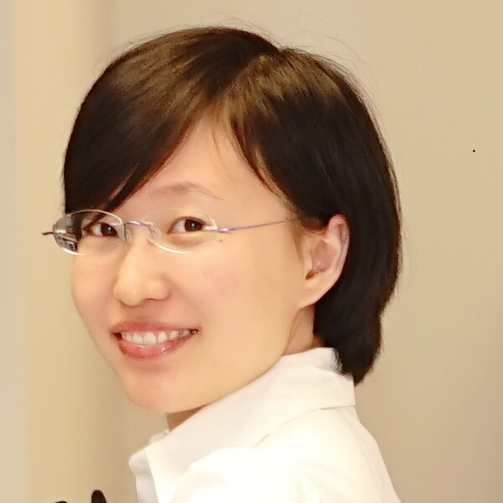
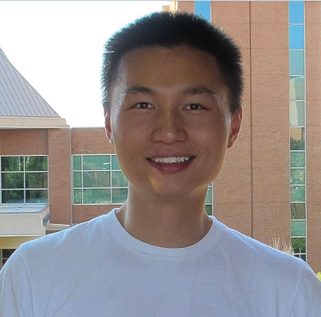
An Empirical Study of Touch-based Authentication Methods on Smartwatches
Yue Zhao*, Zhongtian Qiu*, Yiqing Yang*, Weiwei Li*, Mingming Fan
Department of Computer Science
University of Toronto
*Equal Contribution
Notes:
Hello everyone.
My name is Yue and I am from University of Toronto, Department of Computer Science.
I am very happy to present one of our recent studies on smartwatch authentication systems.
This is an empirical study, and we hope this short paper could bring some extra insights for you☺

Slide 2
Outline
Research Objectives
Experiment Design
Result & Discussion
Accuracy
Speed
Security
Questionnaire
Limitation & Future Directions
Conclusion
Q&A
Notes:
So we will first talk about the goal of the research, how do we design the experiments, results and findings, and some future directions

Slide 3
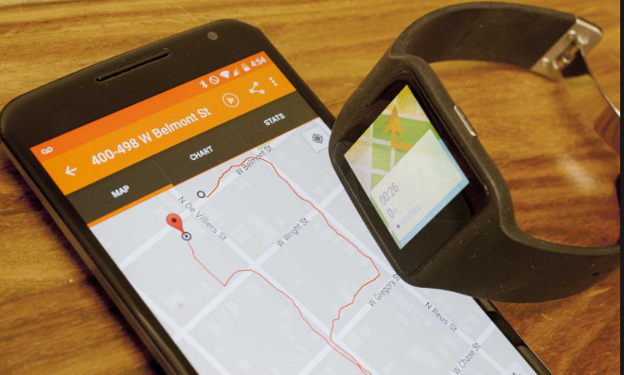
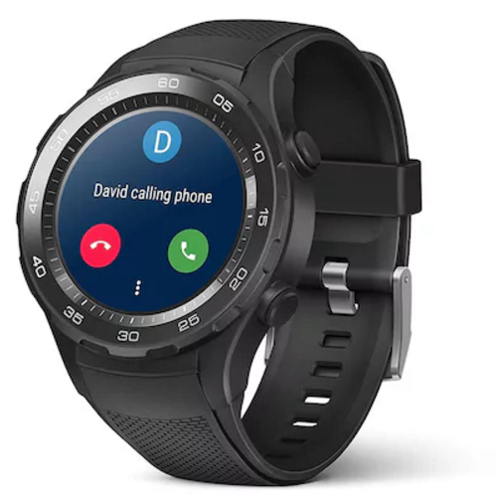
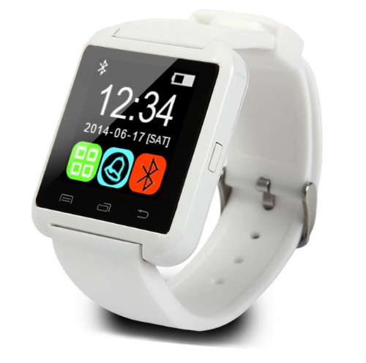
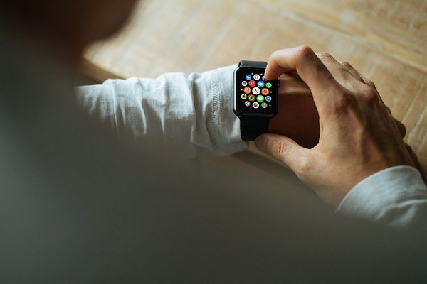
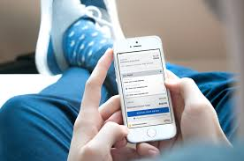
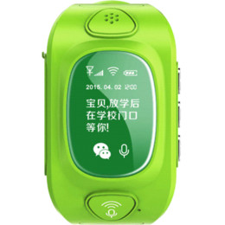
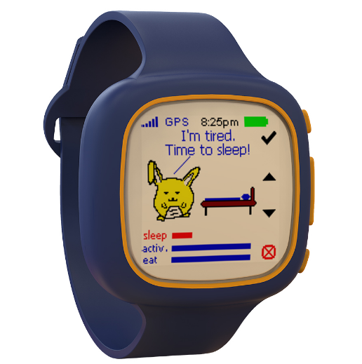
Smartwatches vs. Smartphones
a. Smaller screen size
c. Different ways of interaction
b. Various shapes
Notes:
First thing first, why do we what to investigate the authentication systems on smartwatches?
There are several reasons but the most important one is smartwatches are getting more and more popular.
If you do not believe me, check the people who are sitting around you.
However, the authentication systems on smartwatches are still borrowed from smartphones.
But we all know smartphones and smartwatches could be fundamentally different.
For example, smartwatches are much smaller. The face size is usually around 40mm, but the smartphones are always much larger
Secondly, smartwatches have various shapes. As you could see from the pictures, there are circular, square, rectangular, and oval designs.
I wont be surprised if triangular smartwatches come out finally…
Last but not least, the interaction way of smartwatches is unique as well. For smartphones, people usually use two hands but for smartwatches the interaction way is limited. Wearing it on the wrist differentiate it from smartphone interactions.

Slide 4
Motivation
Understand if popular smartphone authentication mechanisms are appropriate for smartwatches due to the differences in:
Size
Shape & Layout
Way of interaction
Notes:
Therefore, we wonder if we just simply use the popular smartphone authentication systems on the smartwatch,
Will that still be effective? Please keep in mind… we just discussed there are size differences, layout difference(different shapes), interaction difference
All these factors may void the utility of smartphone authentication systems on smartwatches.

Slide 5
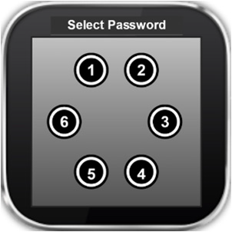
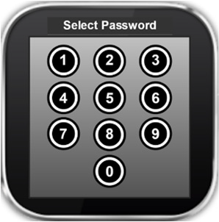
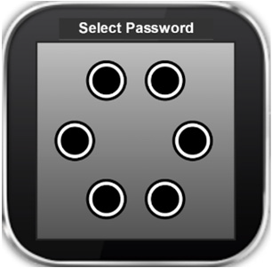
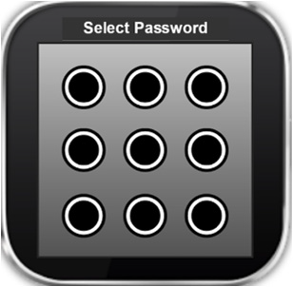
Experiment Design – UI: button arrangement
Index | Size | Authentication Scheme
1 | 38mm | Circular PIN
2 |  | Square PIN
3 |  | Circular Pattern
4 |  | Square Pattern
5 | 42mm | Circular PIN
6 |  | Square PIN
7 |  | Circular Pattern
8 |  | Square Pattern
(a) Circular PIN
(b) Square PIN
(c) Circular Pattern
(d) Square Pattern
Notes:
The second and third independent variables we picked are layouts and authentication methods.
Layout here means the shape of the authentication scheme and the arrangement of the buttons. Authentications methods are PIN passwords and Pattern passwords.
Please be aware that it is not the shape of the smartwatches but the authentication methods.
Because the design of the layout and authentication methods are tied closely, we introduce them together.
So the highlighted design is called circular PIN. We use the dotted circle to make the understanding easier…otherwise it is hard to see why it is called circular. You may notice immediately that it only has 6 buttons instead of 10. We did this modification to keep the size the buttons same and the similar design has been mentioned in multiple papers.

Slide 6
Experiment Design – IV2: Size
Index | Size | Authentication Scheme
1 | 38mm | Circular PIN
2 |  | Square PIN
3 |  | Circular Pattern
4 |  | Square Pattern
5 | 42mm | Circular PIN
6 |  | Square PIN
7 |  | Circular Pattern
8 |  | Square Pattern
38mm
19mm
21mm
42mm
(a) Circular Setting
(a) Square setting
Diameter/edge difference: 9.52%
Area difference: 18.14%
Notes:
So we designed a 3 level experiments, it turns out to be 2*2*2 = 8 different experiments
The first factor is size, we picked two popular smartwatch face size, they are 38mm and 42mm.
Although they look close in the first place, but the area difference is 18% which is not negligible.

Slide 7
Experiment Design – IV3: Authentication Method
Index | Size | Authentication Scheme
1 | 38mm | Circular PIN
2 |  | Square PIN
3 |  | Circular Pattern
4 |  | Square Pattern
5 | 42mm | Circular PIN
6 |  | Square PIN
7 |  | Circular Pattern
8 |  | Square Pattern
(a) Circular PIN
(b) Square PIN
(c) Circular Pattern
(d) Square Pattern
Notes:
The second and third independent variables we picked are layouts and authentication methods.
Layout here means the shape of the authentication scheme and the arrangement of the buttons. Authentications methods are PIN passwords and Pattern passwords.
Please be aware that it is not the shape of the smartwatches but the authentication methods.
Because the design of the layout and authentication methods are tied closely, we introduce them together.
So the highlighted design is called circular PIN. We use the dotted circle to make the understanding easier…otherwise it is hard to see why it is called circular. You may notice immediately that it only has 6 buttons instead of 10. We did this modification to keep the size the buttons same and the similar design has been mentioned in multiple papers.

Slide 8
Experiment Design
Index | Size | Authentication Scheme
1 | 38mm | Circular PIN
2 |  | Square PIN
3 |  | Circular Pattern
4 |  | Square Pattern
5 | 42mm | Circular PIN
6 |  | Square PIN
7 |  | Circular Pattern
8 |  | Square Pattern
(a) Circular PIN
(b) Square PIN
(c) Circular Pattern
(d) Square Pattern
Notes:
Because the design of the layout and authentication methods are tied closely, we introduce them together.
So the highlighted design is called circular PIN. We use the dotted circle to make the understanding easier…otherwise it is hard to see why it is called circular. You may notice immediately that it only has 6 buttons instead of 10. We did this modification to keep the size the buttons same and the similar design has been mentioned in multiple papers.
We control all buttons to be the same size in all designs and all buttons are horizontally and vertically evenly distributed.

Slide 9
Experiment Design
Index | Size | Authentication Scheme
1 | 38 MM | Circular PIN
2 |  | Square PIN
3 |  | Circular Pattern
4 |  | Square Pattern
5 | 42mm | Circular PIN
6 |  | Square PIN
7 |  | Circular Pattern
8 |  | Square Pattern
(a) Circular PIN
(b) Square PIN
(c) Circular Pattern
(d) Square Pattern
Notes:
Similarly, the second authentication scheme we are introducing is called square pin.
This is possibly the default authentication scheme on most of the smart devices.

Slide 10
Experiment Design
Index | Size | Authentication Scheme
1 | 38 MM | Circular PIN
2 |  | Square PIN
3 |  | Circular Pattern
4 |  | Square Pattern
5 | 42mm | Circular PIN
6 |  | Square PIN
7 |  | Circular Pattern
8 |  | Square Pattern
(a) Circular PIN
(b) Square PIN
(c) Circular Pattern
(d) Square Pattern
Notes:
The third one we are introducing is called circular Pattern. Again, we use a dotted circle to highlight the operation area.
We also use these arrows to give you an example how a pattern may look like.
These dotted lines and arrows are imaginary and this is not something the participants would see.

Slide 11
Experiment Design
Index | Size | Authentication Scheme
1 | 38 MM | Circular PIN
2 |  | Square PIN
3 |  | Circular Pattern
4 |  | Square Pattern
5 | 42mm | Circular PIN
6 |  | Square PIN
7 |  | Circular Pattern
8 |  | Square Pattern
(a) Circular PIN
(b) Square PIN
(c) Circular Pattern
(d) Square Pattern
Notes:
The last scheme is square pattern. One difference from square pin is it has only 9 buttons other 10.
This is because that the default setting on Android phones.
We are doing this research based on the popularity measure, so we did not introduce an extra button which is unnatural.

Slide 12
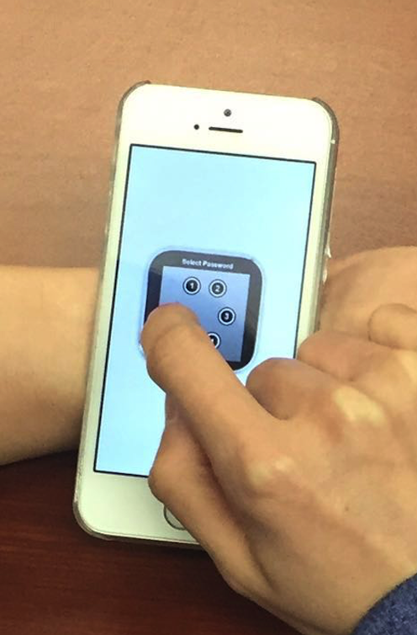
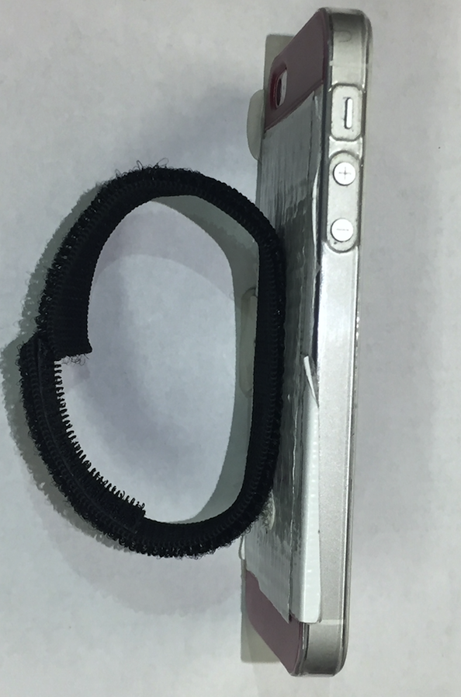
Experiment Design
Simulated smartwatch
Keep external factors constant
A side view of the simulated smartwatch
Notes:
To keep the design running with the same processing speed and interaction experience, we used an IPhone to simulate different designs.
As you can see from the figures, the way of wearing this device is similar to wearing a watch, and the weight are also close.
A simulated smartwatch is displayed at the center of the phone screen so the user can participate the experiment's in this way.
Counterbalanced using 8*8 Latin-Square method. Carry-over effect.
15 trails * 8 (2*2*2 within-subject).

Slide 13
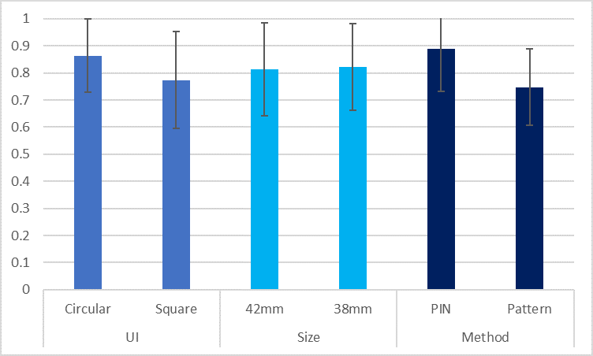
Result & Discussion – DV1: Accuracy
PIN methods > Pattern methods. Potential reasons:
Shorter finger motion on the screen
The fat finger effect; lower chance of visual occlusion
Circular UIs > Square UIs. Potential reasons:
Fewer buttons (6 vs. 9)
Accuracies for different independent variables
Notes:
Let us check out results and findings . Accuracy: which is the average percentage of successful rate of an authentication attempt. Generally speaking, the higher the better
The first one is about the accuracy, I mean the successful rate of the authentication.
After running 3-way anova statistical analysis, we reached out the conclusion that Pin methonds are more accurate the Pattern methods.
We have two assumptions:
Pattern methods requires longer finger motion on the screen which may increase the chance of failure.
The second one is fat finger effect. Using such a small devices could be hard, drawing a pattern needs to be continuous which is not easy.
75% of the participants complains that they could not see the screen while drawing patterns.

Slide 14
Result & Discussion – DV1: Accuracy
PIN methods > Pattern methods. Potential reasons:
Shorter finger motion on the screen
The fat finger effect; lower chance of visual occlusion
Circular UIs > Square UIs. Potential reasons:
Fewer buttons (6 vs. 9)
Accuracies for different independent variables
Notes:
We also found that circular layouts are more accurate. Possibly that is because we have only buttons for circular design.
Again, we are not saying circular design is better than square. Just want be clear with that.

Slide 15
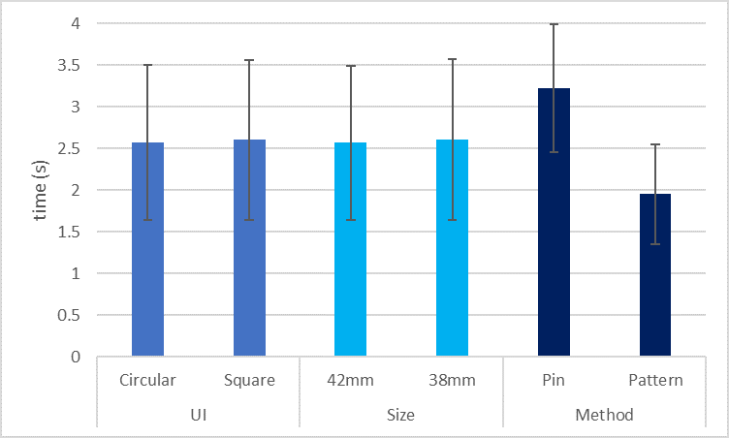
Result & Discussion – DV2: peed
Pattern methods > PIN methods.
Potential reasons:
Pattern methods do not require repetitive touches on the screen
UI and Display Size show NO significant effect.
Time for different independent variables
Notes:
For the result of UI, there is no eta-square?
Inconsistency: In the paper, UI was used for the accuracy result but shaped was used for speed.

Slide 16
Result & Discussion – DV2: Speed
Pattern methods > PIN methods.
Potential reasons:
Pattern methods do not require repetitive touches on the screen
UI and Display Size show NO significant effect.
Time for different independent variables
Notes:
For the result of UI, there is no eta-square?
Inconsistency: In the paper, UI was used for the accuracy result but shaped was used for speed.

Slide 17
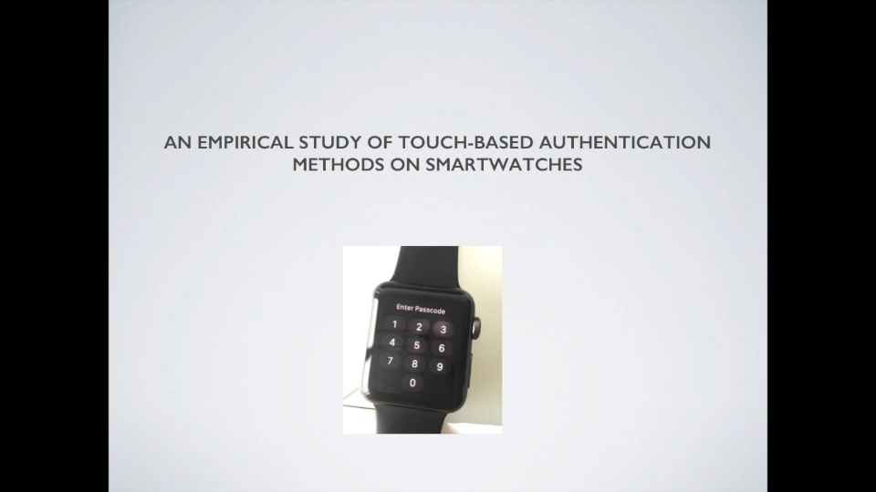
DV3: Security – Shoulder Surfing Attack
(a) Shoulder surfing demo (video)
(b) the shoulder surfing test
Notes:
We have 16 participants, each of them will try these 8 different authentication schemes using the simulated sw.
We measure 3 things to evaluate the performance:
Speed: which is the average time required for unlocking. Generally speaking, the faster the better
An attacker can obtain the PIN either by directly looking over the victim's shoulder or by recording the whole login process.
Security: there are many measures for security, we specifically choose shoulder surfing. So what is shoulder surfuing, let us see a short video. We pick this one because it is one of popular security concerns and it happens everywhere.

Slide 18
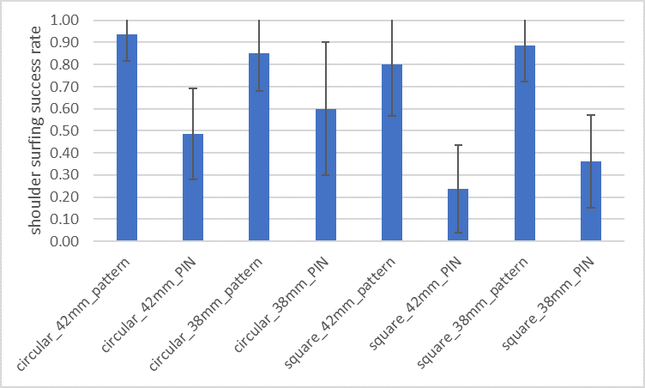
Result & Discussion – DV3: Security
PIN methods > Pattern methods.
Potential reasons:
The trace of finger’s motion
Easier to memorize pattern password
Square UIs > Circular UIs. Potential reasons:
More buttons ( 9 vs. 6)
Square PIN is the most secure method of all.
Shoulder surfing attack success rates of all conditions
Notes:
The symbol in F cannot be displayed.
Attack success rates on UI: Circular (M:.72, SD:.28), Square (M:.57, SD:.34).
Attack success rates on size: 42mm (M:.62, SD:.33), 38mm (M:.68, SD:.30).
Attack success rates on method: PIN (M:.42, SD:.26), Pattern (M:.87, SD:.18),;

Slide 19
Result & Discussion – DV3: Security
PIN methods > Pattern methods.
Potential reasons:
The trace of finger’s motion
Easier to memorize pattern password
Square UIs > Circular UIs. Potential reasons:
More buttons (9 vs. 6)
Square PIN is the most secure method of all.
Shoulder surfing attack success rates of all conditions
Notes:
The symbol in F cannot be displayed.
Attack success rates on UI: Circular (M:.72, SD:.28), Square (M:.57, SD:.34).
Attack success rates on size: 42mm (M:.62, SD:.33), 38mm (M:.68, SD:.30).
Attack success rates on method: PIN (M:.42, SD:.26), Pattern (M:.87, SD:.18),;

Slide 20
Result & Discussion - Security
PIN methods > Pattern methods.
Potential reasons:
The trace of finger’s motion
Easier to memorize pattern password
Square UIs > Circular UIs. Potential reasons:
More buttons
Square PIN is the most secure method of all.
Shoulder surfing attack success rates of all conditions
Notes:
The symbol in F cannot be displayed.
Attack success rates on UI: Circular (M:.72, SD:.28), Square (M:.57, SD:.34).
Attack success rates on size: 42mm (M:.62, SD:.33), 38mm (M:.68, SD:.30).
Attack success rates on method: PIN (M:.42, SD:.26), Pattern (M:.87, SD:.18),;

Slide 21
Result & Discussion - Subjective Feedbacks
Speed: Pattern methods > PIN methods
Security: Square methods > Circular methods
Square Pattern is the most favourite method:
Potential reason: one of the dominant schemes on smartphones
Security concern: NOT the best in any measures
77% vs. 23%
Notes:
Most (77%) considered Pattern methods to be faster than PIN methods, with Square Pattern (39%) having slightly more votes than Circular Pattern (38%). Square UI were considered more secure than Circular UI, whereas there was no bias between Square Pattern and Square PIN, both of which got 43% votes. They intuitively thought more dots (Square UIs) could lead to better security. For the overall preference, Pattern methods were preferred by most participants compared to PIN ones. Specifically, Square Pattern was the most favorite method with 50% of participants’ votes. 36% liked Circular Pattern most and the two PIN methods only got 7% votes each.
Results indicate majority of the participants think Pattern methods require less authentication time, which is in line with our analysis. Participants think Square methods are more secure than Circular methods, which is also consistent with our results. In terms of subjective preference, the most favorite method is Square Pattern. One possible reason is that people are more familiar with it because it is one of the dominant authentication methods on smartphones [3]. However, this raises a security concern because Square Pattern is not the best in any measures.

Slide 22
Result & Discussion - Subjective Feedbacks
Speed: Pattern methods > PIN methods
Security: Square UIs > Circular UIs
Square Pattern is the most favourite method:
Potential reason: one of the dominant schemes on smartphones
Security concern: NOT the best in any measures
86% vs. 14%
Notes:
Most (77%) considered Pattern methods to be faster than PIN methods, with Square Pattern (39%) having slightly more votes than Circular Pattern (38%). Square UI were considered more secure than Circular UI, whereas there was no bias between Square Pattern and Square PIN, both of which got 43% votes. They intuitively thought more dots (Square UIs) could lead to better security. For the overall preference, Pattern methods were preferred by most participants compared to PIN ones. Specifically, Square Pattern was the most favorite method with 50% of participants’ votes. 36% liked Circular Pattern most and the two PIN methods only got 7% votes each.
Results indicate majority of the participants think Pattern methods require less authentication time, which is in line with our analysis. Participants think Square methods are more secure than Circular methods, which is also consistent with our results. In terms of subjective preference, the most favorite method is Square Pattern. One possible reason is that people are more familiar with it because it is one of the dominant authentication methods on smartphones [3]. However, this raises a security concern because Square Pattern is not the best in any measures.

Slide 23
Result & Discussion - Subjective Feedbacks
Speed: Pattern methods > PIN methods
Security: Square methods > Circular methods
Square Pattern is the most favourite method:
Potential reason: one of the dominant schemes on smartphones
Security concern: NOT the best in any measures
Square Pattern
>50%
Notes:
Most (77%) considered Pattern methods to be faster than PIN methods, with Square Pattern (39%) having slightly more votes than Circular Pattern (38%). Square UI were considered more secure than Circular UI, whereas there was no bias between Square Pattern and Square PIN, both of which got 43% votes. They intuitively thought more dots (Square UIs) could lead to better security. For the overall preference, Pattern methods were preferred by most participants compared to PIN ones. Specifically, Square Pattern was the most favorite method with 50% of participants’ votes. 36% liked Circular Pattern most and the two PIN methods only got 7% votes each.
Results indicate majority of the participants think Pattern methods require less authentication time, which is in line with our analysis. Participants think Square methods are more secure than Circular methods, which is also consistent with our results. In terms of subjective preference, the most favorite method is Square Pattern. One possible reason is that people are more familiar with it because it is one of the dominant authentication methods on smartphones [3]. However, this raises a security concern because Square Pattern is not the best in any measures.

Slide 24
Limitation & Future Directions
Limitation: evaluated Pattern with Trace only
Future direction: incorporate Pattern without Trace
Limitation: considered Circular and Square only
Future direction: test on more uncommon shapes
Limitation: provided limited design guidance
Future direction: build a recommender system for authentication initialization
(a) Pattern with a trace
(b) Pattern without a trace

Slide 25
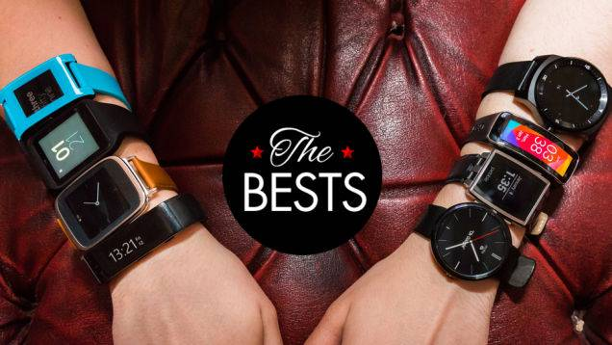
Limitation & Future Directions
Limitation: evaluated Pattern with Trace only
Future direction: incorporate Pattern without Trace
Limitation: considered Circular and Square only
Future direction: test on more uncommon shapes
Limitation: provided limited design guidance
Future direction: build a recommender system for authentication initialization
(a) Various shapes to evaluate

Slide 26
Limitation & Future Directions
Limitation: evaluated Pattern with Trace only
Future direction: incorporate Pattern without Trace
Limitation: considered Circular and Square only
Future direction: test on more uncommon shapes
Limitation: provided limited design guidance
Future direction: build a recommender system for authentication initialization
Which would fit you better?

Slide 27
Conclusion
Design Trade-off for PIN and Pattern methods:
Accuracy & Security: PIN > Pattern.
Speed: Pattern > PIN
Design Trade-off for Square and Circular UIs:
Security: Square > Circular
Accuracy: Circular > Square
Speed: UIs do not affect speed significantly.
Notes:
Yue
In our paper conclusion 4 directly jumped to conclusion 6, and there was no conclusion 5.
Add the conclusion of conclusion? ”As the first empirical validation work on touch-based authentication methods on smartwatches, our results provide insights for app developers in designing authentication methods by considering tradeoffs between accuracy, speed and security.”

Slide 28
Conclusion
The display size does not affect accuracy or speed, but security.
Square PIN is the most secure method of all.
Users’ most preferred method is Square Pattern, which is NOT the best in any measure.
Notes:
Yue
In our paper conclusion 4 directly jumped to conclusion 6, and there was no conclusion 5.
Add the conclusion of conclusion? ”As the first empirical validation work on touch-based authentication methods on smartwatches, our results provide insights for app developers in designing authentication methods by considering tradeoffs between accuracy, speed and security.”

Slide 29
An Empirical Study of Touch-based Authentication Methods on Smartwatches Yue Zhao*, Zhongtian Qiu*, Yiqing Yang*, Weiwei Li*, Mingming Fan Department of Computer Science University of Toronto
(a) Circular PIN
(b) Square PIN
(c) Circular Pattern
(d) Square Pattern
*Equal Contribution
Notes:
Note: it is 3-way repeated-measure ANOVA. "repeated-measure" is critical. Partial eta-squared measure does not need to mentioned. During the Q&A session, if someone asks about how did you measure the effect size? You can explain that we used partial eta square to measure effect size.

